Slide 1
GP to CPCS early adopter – Expression of interest received
ICP | Practice / PCN | # of practices
NWS | SASSE 2 PCN | 5
NWS | SASSE 3 PCN | 4
NWS | WISE 3 PCN | 3
NWS | SASSE 1 PCN | 4
NWS | CoCO PCN | 3
NWS | WHAM PCN | 4
G&W | North Guildford PCN | 4
SD | Epsom PCN | 7
SD | Leatherhead PCN | 6
SD | East Elmbridge PCN | 7
ES | Care Collaborative PCN | 3
ES | North Tandridge | 4
 | Total = 12 PCNs | 54

Slide 2
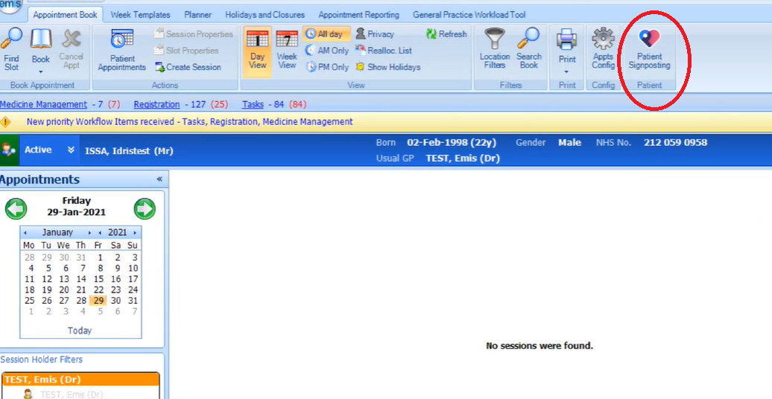
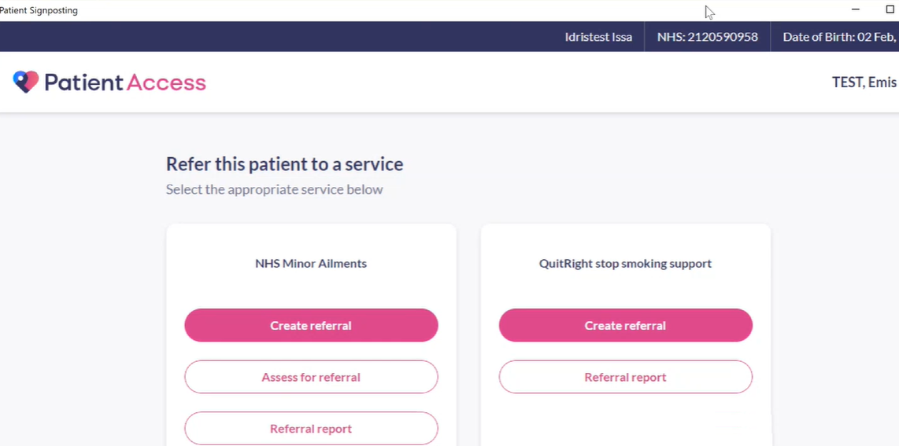
EMIS integrated solution – Preferred option
Video: https://www.youtube.com/watch?v=DB46_1Lhd-Q&t=14s
Stage 1
Stage 1: Software changes in EW to enable CPCS service - Done
Stage 2
EMIS to activate patient access button for 12 PCNs i.e. 54 practices
Stage 3
Go-live – lead time 1 week
Lead time around 4 week
Each week we can request EMIS to activate a number of PCNs and they will be live the week next
Service will not be enabled

Slide 3
Draft Plan on a Page
Apr 21 | May | Jun | Jul | Aug | Sep
Funding approved by PCCC
Contract + IG + CG +TG plan
Set up the project and resources
Pilot - Project initiated in two PCN
Proof of Concept - Wise 3 and Care Collaborative? Evaluation of SOP, training materials and plan the next release
EMIS button enabled
Other Early adopter PCNs – 2 more stages
SASSE1, SASSE3, EPSOM, East Elmbridge , North Tandridge
Leatherhead, North Guildford, SASSE2, COCO, WHAM
On-board other PCNs for Oct – Mar rollout

